Slide 1
Local Irrigator perspective of River Murray Management Brendan Sidhu – CEO Jubilee Almonds/Century Orchards

Slide 2
Jubilee Almonds & Century Orchards specialise in the business of growing quality Almonds on a sustainable basis, providing maximum returns.
Jubilee Almonds: 480ha Almonds
Century Orchards: 540ha Almonds 100ha Wine Grapes
- by 2017 will be 600ha almonds

Slide 3
River Management
From this irrigators experience
South Australian irrigators have been world leaders in water use efficiency
SA extraction has been capped since 1969
The River Murray has been managed well
One of the best managed rivers in the world
In the early 90’s salinity at Jubilee was up to 600EC units now less than 200EC units

Slide 4
Influence of the MDBA Plan
Over allocation of Murray River
MDBA Plan works to address over allocation
Recovery of 2750GL
SA River Murray Community Group input into development of MDBA Plan
Currently we have access to 1850GL
645GL for irrigators of which nearly half is held by the CEWH
SA irrigators have agreed to the changes but want security in future droughts
Confusion between ‘water savings’ and ‘irrigation efficiency’

Slide 5
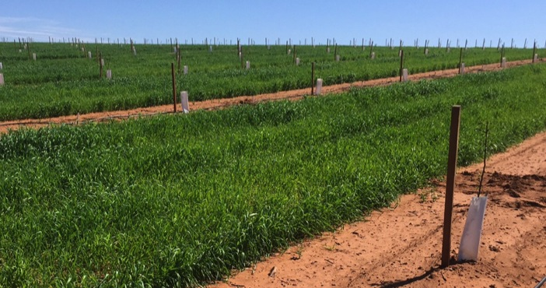
PIIP / OFIEP / SARMS
Water saving initiative programs introduced prior to and as part of the MDBA Plan
Has helped recover water through irrigation infrastructure upgrades

Slide 6
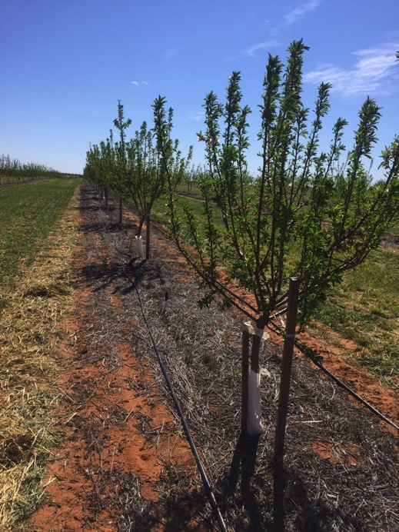
Jubilee Almonds
PIIP - SA Round 2
Subsurface drip replacement
Pump Upgrade | ML Returned
Filter Upgrade | 100
OFIEP - Round 3
Mainline upgrade
Soil moisture monitoring upgrade | ML Returned
112ha Irrigation upgrade | 383
SARMS - Round 1
166ha Replant
Pumphouse Redevelopment | ML Returned
Almond Drying System | 1,113
 | ML Returned
 | 1,596
Century Orchards
OFIEP – Round 3
135ha Drip Conversion | ML Returned
Pump Upgrade | 205.5
SARMS Round 1
Filter Upgrade
Soil moisture monitoring upgrade Almond Drying System | ML Returned
319ha Drip Conversion | 960
SARMS - Round 2
Convert 85ha vineyard to 55ha almonds | ML Returned
Full automation of irrigation system | 310
 | ML Returned
 | 1,476

Slide 7
Summary
Take Home Messages
The river system has been managed well
On going review of the legislation with irrigator participation
Initiatives for water buy back and infrastructure upgrades have been managed very well by the NRM board & PIRSA
Irrigators should have confidence that the river is now a sustainable resource

